Slide 1
Language Theory II
Adeesha Wijayasiri

Slide 2
Topics
Define Finite-State Automata
Non-Determinism
Define Regular Expressions
Conversion from Right-Linear Grammar to Regular Expression
Writing a scanner using DFA in table form.
Writing a hard-coded scanner.
Writing a scanner for real,
i.e. for a programming language.

Slide 3
Finite-state automata
Definition: A (non-deterministic) finite-state automaton
is a 5-tuple M = (Q, Σ, δ, s, F), where
Q is a finite set of states,
Σ is a finite set of transition symbols,
δ: Q x Σ ∪ {ε} → 2^{Q} is the
transition function,
s ∈ Q is called the start state, and
F ⊆ Q is the set of final states.
An FSA is the formal accepting (parsing)
mechanism of a regular language.

Slide 4
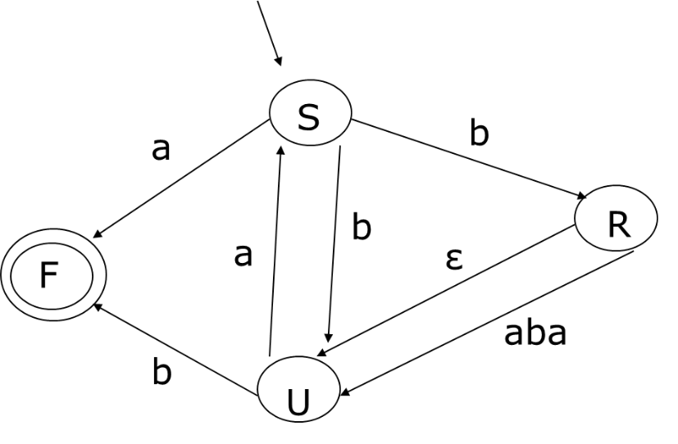
Finite-state automata
FSA: ({S, R, U, F, X, Y}, {a, b}, δ, S, {F}),
where
δ (S, a) = {F}
δ (S, b) = {U, R}
δ (R, ε) = {U}
δ (R, a) = {X}
δ (U, a) = {S}
δ (U, b) = {F}
δ (X, b) = {Y}
δ (Y, a) = {U} FSA requires each transition
labeled by a string of length < 1.
a
R
X
b
X
Y
a
Y
U

Slide 5
Finite-state automata
TWO “SYMPTOMS” OF NON-DETERMINISM:
NOTE: is not a problem.
a
ε
1.
X
a
2.
X
a
a
F

Slide 6
Finite-state automata
Advantage of FSA’s: What language does this grammar generate?
S → aA A → aB B → aC
→ ε → E → D
C → bD D → bE E → bS
Difficult to see. Try FSA.
Answer:
L={ab, aabb, aaabbb}
ε
a
a
F
S
A
B
ε
ε
a
b
b
b
E
D
C

Slide 7
Finite-state automata
Conversion: FSA to Right-linear regular grammar
Φ = Q
A → aB if B ∈ δ (A, a)
A → a if f ∈ δ (A, a), and f ∈ F
Start symbol = Start state
A → aB B → bB D → cE
→ a → bD → c
E → F → b G → H
H → A F → dG → ε
Conclusion: Right- linear regular grammars and
FSA’s are equivalent.
b
a
b
c
A
B
D
E
ε
ε
ε
d
H
G
F

Slide 8
Regular expressions
A compact, easy-to-read language description.
Use operators to denote the language constructors described earlier, to build complex languages from simple atomic ones.

Slide 9
Regular expressions
Definition: A regular expression over an alphabet Σ
is recursively defined as follows:
ø denotes language ø
ε denotes language {ε}
a denotes language {a}, for all a ∈ Σ.
(P + Q) denotes L(P) U L(Q), where P, Q are r.e.’s.
(PQ) denotes L(P)·L(Q), where P, Q are r.e.’s.
P* denotes L(P)*, where P is a r.e.

Slide 10
Regular expressions
Examples:
(O + 1)*: any string of O’s and 1’s.
(O + 1)*1: any string of O’s and 1’s, ending with a 1.
1*O1*: any string of 1’s with a single O inserted.
Letter (Letter + Digit)*: an identifier.
Digit Digit*: an integer.
Quote Char* Quote: a string. †
# Char* Eoln: a comment. †
{Char*}: another comment. †
† Assuming that Char does not contain quotes, eoln’s, or } .

Slide 11
Regular expressions
Aditional Regular Expression Operators:
a⁺ = aa* (one or more a’s)
a?= a + ε (one or zero a’s, i.e. a is optional)
a list b = a (b a )* (a list of a’s, separated by b’s)
Examples:
Syntax for a function call: Name '(' Expression list ',' ')'

Slide 12
Regular expressions
Conversion from Right-linear grammars to regular expressions
S → aS R → aS S → aS means L(S) ⊇ {a}·L(S)
→ bR S → bR means L(S) ⊇ {b}·L(R)
→ ε S → ε means L(S) ⊇ {ε}
Together, they mean that
L(S) = {a}·L(S) + {b}·L(R) + {ε}, or
S = aS + bR + ε
Similarly, R → aS means L(R) = {a} ·L(S), or R = aS.
Thus, S = aS + bR + ε System of simultaneous equations.
R = aS The variables are the nonterminals.

Slide 13
Regular expressions
Solving a system of simultaneously equations.
S = aS + bR + ε
R = aS
Back substitute R = aS:
S = aS + baS + ε
S = (a + ba) S + ε
S = (a + ba)* ε
S = (a + ba)*

Slide 14
Regular expressions
In general, what to do with equations of the form
X = αX + β ?
Answer: β ∈ L(x), so αβ ∈ L(x),
ααβ ∈ L(x),
αααβ ∈ L(x), …
Thus α*β = L(x).

Slide 15
Regular expressions
Conversion from Right-linear grammars to regular expressions
1. Set up equations:
A = α₁ + α₂ + … + α_{n} if A → α₁
→ α₂
. . .
→ α_{n}

Slide 16
Regular expressions
2. If equation is of the form X = α, and X does not appear in α, then replace every occurrence of X with α in all other equations, and delete equation X = α.
3. If equation is of the form X = αX + β, and X does not
occur in α or β, then replace the equation with X = α*β.
Note: Some algebraic manipulations may be needed to
obtain the form X = αX + β.
Important: Catenation is not commutative!!

Slide 17
Regular expressions
Example:
S → a R → abaU U → aS
→ bU → U → b
→ bR

Slide 18
Regular expressions
S = a + bU + bR
R = abaU + U = (aba + ε) U
U = aS + b
Back substitute R:
S = a + bU + b(aba + ε) U
U = aS + b
S = a + bU + b(aba + ε) U
U = aS + b
Back substitute U:
S = a + b(aS + b) + b(aba + ε)(aS + b)
= a + baS + bb + babaaS + babab + baS + bb
= a + baS + bb + babaaS + babab
= (ba + babaa) S + (a + bb + babab)
and therefore
S = (ba + babaa)*(a + bb + babab)

Slide 19
NFA->DFA
Deterministic Finite-State Automata (DFA’s)
Definition: A deterministic FSA is defined just like an NFA, except that
δ: Q x Σ → Q, rather than
δ: Q x Σ U {ε}→ 2^{Q}
Thus, both and are impossible.
For every NFA there exists an equivalent DFA
(accepting the same language).
ε
a
a

Slide 20
NFA->DFA
Conversion from NFA’s to DFA’s:
Simulate NFA moves with the DFA.
DFA start state:
NFA start state S, and all ε-reachable states from S.
Each DFA state:
a subset of the set of NFA states.
New DFA states:
Calculate the states reachable through each t ∈ Σ.
Final DFA states:
contain any NFA final state.

Slide 21
NFA->DFA
NFA:
a
Input
State a b
123 23 456
23 23 6
456 56 ---
6 --- ---
56 56 ---
In general, if NFA has N states,
The DFA can have as many as 2^{N} states.
2
ε
3
ε
b
1
a
6
b
ε
ε
4
5
DFA:
a
b
6
a
23
123
b
a
456
56
a

Slide 22
NFA->DFA
NFA: from
ba(a+b)*ab
ε
a
4
5
ε
ε
ε
a
b
0
b
1
a
2
ε
3
8
9
10
11
ε
6
7
ε
b
ε

Slide 23
NFA->DFA
NFA: from
ba(a+b)*ab
ε
a
4
5
ε
ε
ε
a
b
0
b
1
a
2
ε
3
8
9
10
11
ε
6
7
ε
b
State a b
0 --- 1
1 234689 ---
234689 34568910 346789
34568910 34568910 34678911
346789 34568910 346789
34678911 34568910 346789
ε
a
DFA:
a
34568910
b
0
b
1
a
234689
a
a
34678911
b
346789
b
b

Slide 24
DFA-> Minimum DFA
Given a DFA M, there exists an equivalent minimal
DFA M’: no other equivalent DFA exists with fewer states than M’.
State Minimization:
Will build MDFA from DFA.
Start with two states: final and non-final.
Split states only if necessary: minimum # of states.

Slide 25
DFA-> Minimum DFA
Definition: A partition of a set S is a set of subsets
of S so that every element of S appears in exactly one
of the subsets.
Example: S = {1, 2, 3, 4, 5}
Π₁ = { {1, 2, 3, 4}, {5} }
Π₂ = { {1, 2, 3,}, {4}, {5} }
Π₃ = { {1, 3}, {2}, {4}, {5} }
Π₂ is a refinement of Π₁ , and Π₃ is a refinement of Π₂.

Slide 26
DFA-> Minimum DFA
Minimization Algorithm:
Remove all undefined transitions by introducting a TRAP state, from which no final state is reachable.
Partition all states into two groups (final states and non-final states).
Complete the “Next State” table for each group, by specifying transitions from group to group.
Form the next partition: split groups in which Next State table entries differ.
Repeat 3,4 until no further splitting is possible.
Determine start and final states.

Slide 27
DFA-> Minimum DFA
a
b
Example:
Π₀ = { {1, 2, 3, 4}, {5} }
St. a b
1234 1234
1234 1234
1234 1234
1234 5
1234 1234
a
2
4
1
a
a
b
b
b
a
3
5
1
2
3
4
5
b
Split {4} from partition {1,2,3,4}:
Π₁ = { {1, 2, 3},{4}, {5} }

Slide 28
DFA-> Minimum DFA
a
b
Π₁ = { {1, 2, 3},{4}, {5} }
St. a b
123 123
123 4
123 123
123 5
123 123
a
2
4
1
a
a
b
b
b
a
3
5
1
2
3
4
5
b
Split {2} from partition {1,2,3}
Π₂ = { {1, 3}, {2}, {4}, {5} }

Slide 29
DFA-> Minimum DFA
a
b
Π₂ = { {1, 3},{2},{4}, {5} }
St. a b
2 13
2 13
2 4
2 5
2 13
a
2
4
1
a
a
b
b
b
a
3
5
1
3
2
4
5
b
No more splitting !
b
13
b
a
a
5
a
2
Minimal DFA:
a
b
b
4

Slide 30
Writing a scanner

Slide 31
Writing a scanner
a
b
Table-driven
Scanner:
ST a b
2 3
2 4
2 3
2 5
2 3
a
2
4
Token scan() {
Token t=empty();
S=1;
while S not in [5] && c ≠ null {
if ST[S,c] = “_”
{ Error(c); c=getchar(); continue; }
else
{S=ST[S,c]; t=t+c; c=getchar(); }
}
return t;
} // assume c is previously read;
1
a
a
b
b
b
a
3
5
b
1
2
3
4
5

Slide 32
Writing a scanner
Token scan() {
Token t=empty();
S=1;
while S not in [5] && c ≠ null {
case S of
1: case c of a: S=2; b: S=3; end;
2: case c of b: S=4; end;
3: case c of a: S=2; end;
4: case c of a: S=2; b: S=5; end;
5: case c of a: S=2; b: S=3; end;
end;
t=t+c; c=getchar();
}
return t;
} // assume c is previously read;
a
b
a
2
4
1
a
a
b
b
b
a
3
5
b
Hard-coded Scanner:

Slide 33
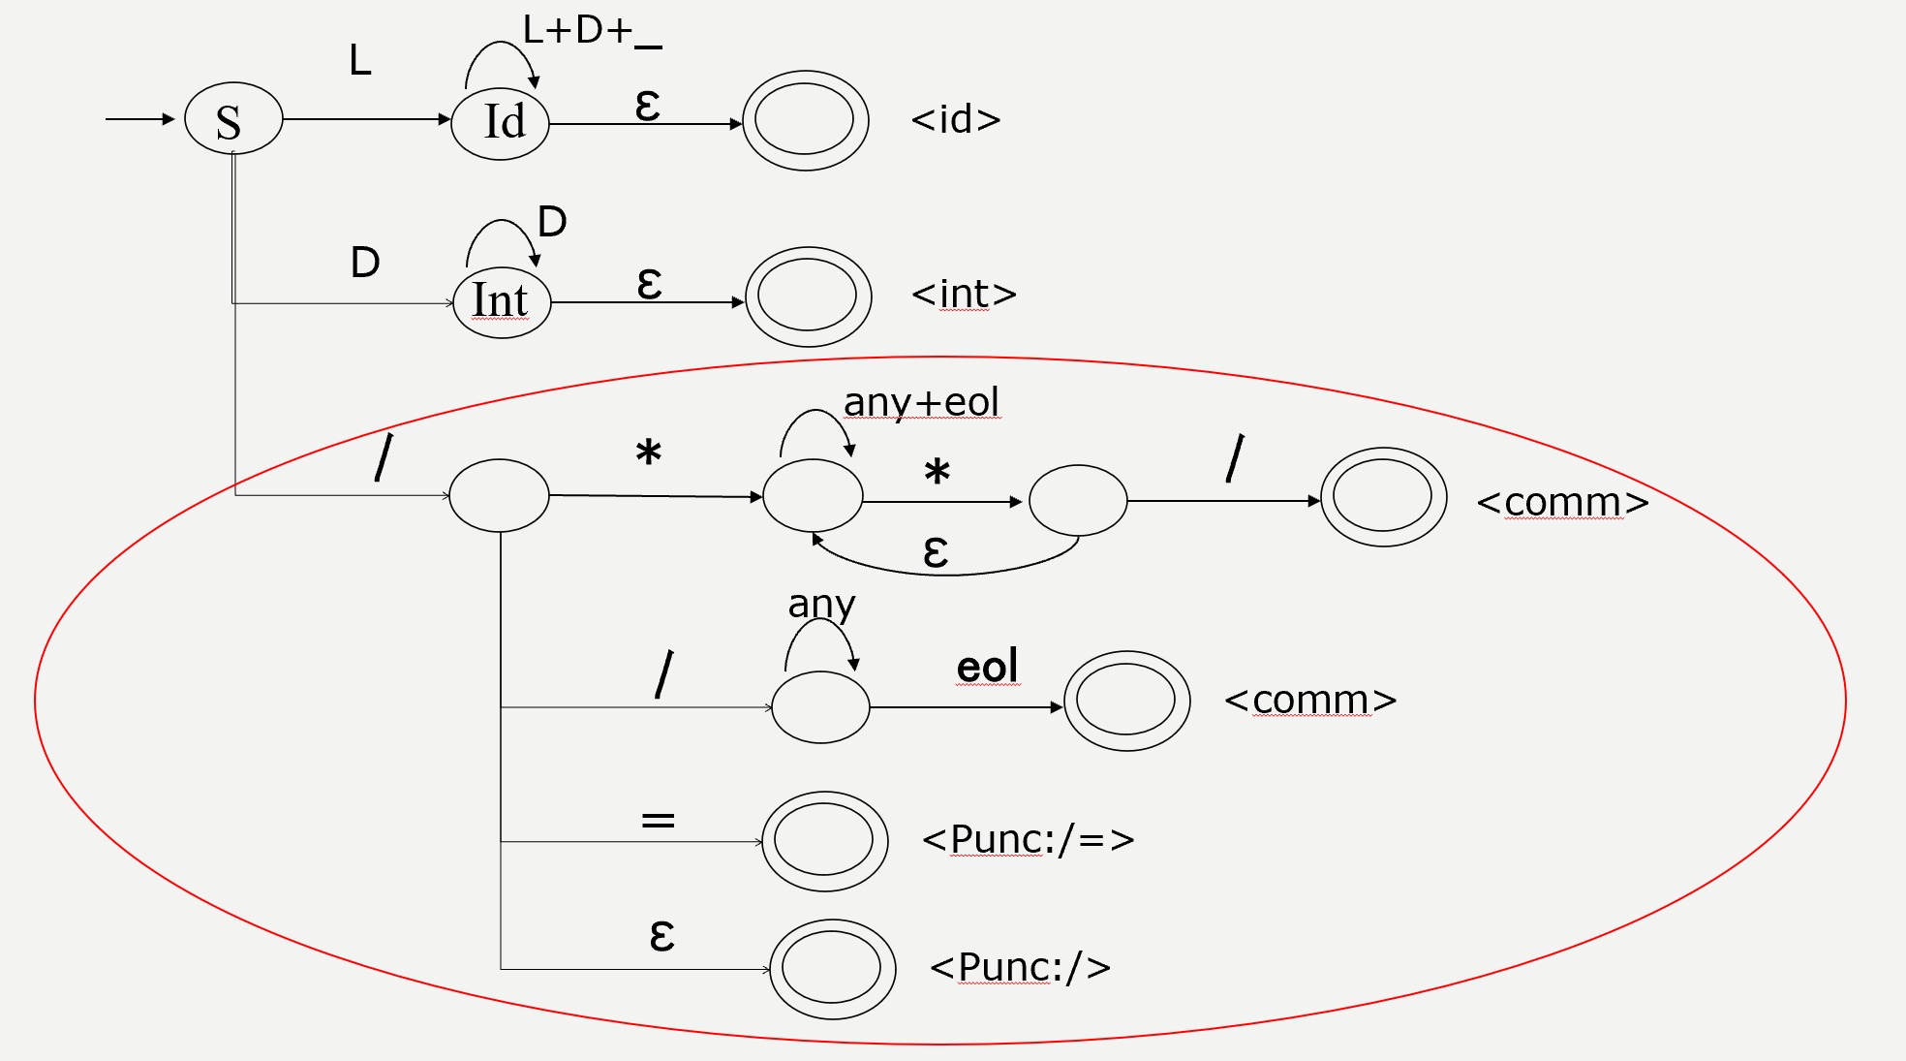
Writing a scanner (for real, i.e. PL’s)

Slide 34
Acknowledgements
Programming Language Pragmatics by Michael L. Scott. 3rd edition. Morgan Kaufmann Publishers. (April 2009).
Lecture Slides of Dr.Malaka Walpola and Dr.Bermudez

